Slide 1


Game Station
Content /
Game Station
Best place of game trade
INTRODUCTION 00
ARCHITECTURE 01
Tech stack 02
Data model 03
Demo 04
Reflection 05
The next step 06
L I n L i
Y u G a o
Pan Wang

Slide 2
Game Station
Content /
Game Station
Best place of game trade
INTRODUCTION 00
ARCHITECTURE 01
Tech stack 02
Data model 03
Demo 04
Reflection 05
The next step 06
L I n L i
Y u G a o
Pan Wang

Slide 3
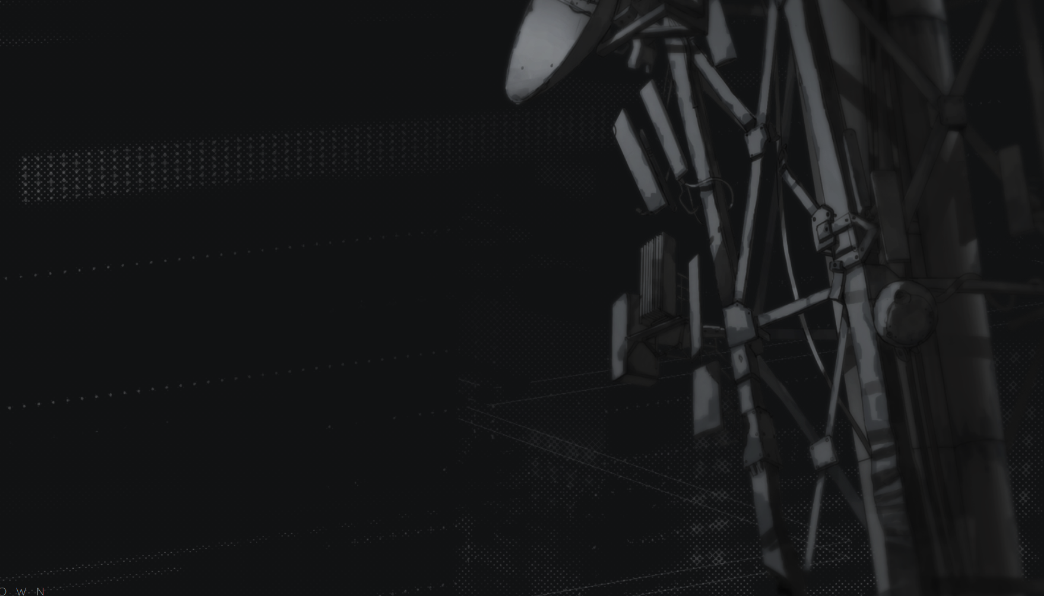


INTRODUCTION
#pROBLEM
#solution
There are few platforms designed specifically for video game players around the nation to trade their second-handed video games.
These existing platforms, such as GameStop, make big profits by offering lower prices for second-hand games to game owners and then selling them at significantly higher prices.
So, it’s not easy for game players around the nation to search for second-handed games and buy/sell them at fair prices.
SELLER
↑ $20
MIDDLE MAN
↓ $60
CONSUMER

Slide 4
INTRODUCTION
#pROBLEM
#solution
We created a website called Game Station, where game players in Canada can trade second-handed games with the least amount of effort.
It’s an end-to-end platform. Every user has two roles: game seller and game buyer. We just bring them together for sharing. There are no intermediate fees.
MIDDLE MAN

Slide 5
ARCHITECTURE
Homepage
- Viewed History
- Today’s Pick
- Platform-Based Contents
Game Details
- Scroll Images
- Location based on Google Map
- Comment
- Seller Profile
Game Search
- Keyword Search
- Today’s Pick
NAV BAR
Edit Game
- Update Images
- Update / Delete Item
Game Sell
- Multi-Picture Upload
- Detail Upload
Login / Profile
- Edit Avatar
- Manage Posted Games

Slide 6







TECH STACK
EXPRESS
···
DATA MODEL

Slide 7
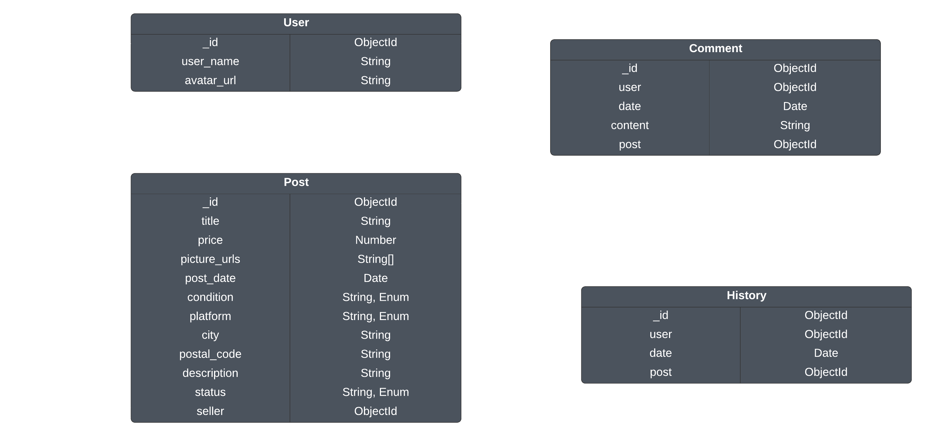
DATA MODEL – DB SCHEMA

Slide 8
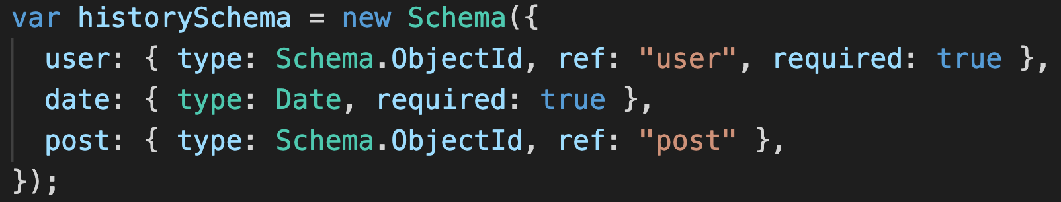
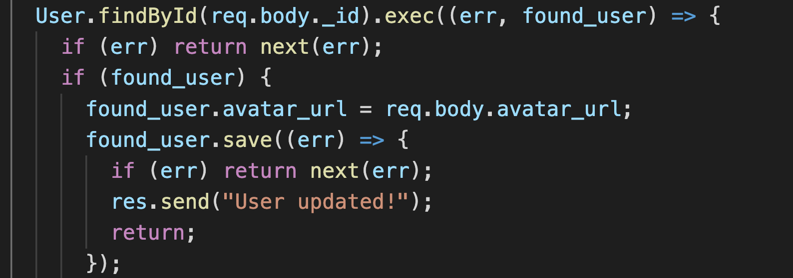
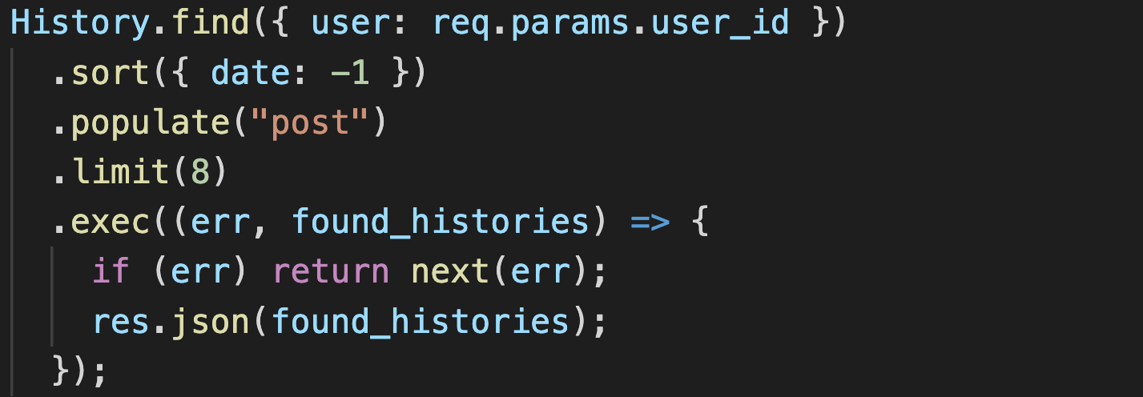
DATA MODEL – MONGOOSE
Why Mongoose?
Mongoose maps document operations to object operations.
Mongoose has simpler APIs, such as save(which is a combination of insert and update), findByIdAndUpdate, findByIdAndRemove, etc.
Mongoose can populate objects from reference ids, which is so powerful and convenient.

Slide 9
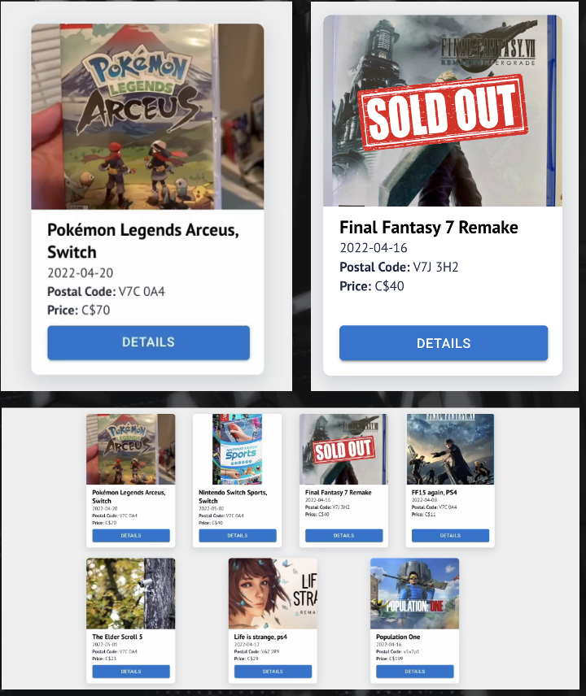
REFLECTION
#PROUDEST FEATURES – GAMECARD
There’ll be an animation transition to guide users to Details page when a mouse hovers on a game card image (desktop only)
A SOLD OUT watermark will be shown on the image if this game’s status is SOLD, to help users to determine game status with a glance
Using the Flex layout and flex-wrap: wrap, the card section is responsive and can decide how many cards one line should hold and always make the cards aligned to center horizontally

Slide 10
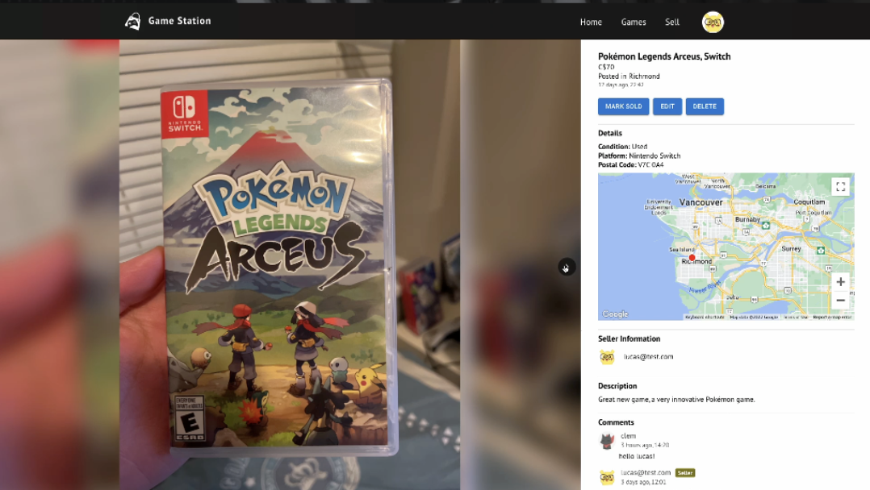
REFLECTION
#PROUDEST FEATURES – multi images display
Because a game can have multiple images. A Carousel component is used to help users to navigate between images.
Each Picture Item has multiple images, including a blurred background in the behind and a clear image in the front. We used display: relative and display: absolute to put images on top of another.
When the MARK SOLD button is clicked, a SOLD OUT watermark will show on the front of each Picture Item.

Slide 11
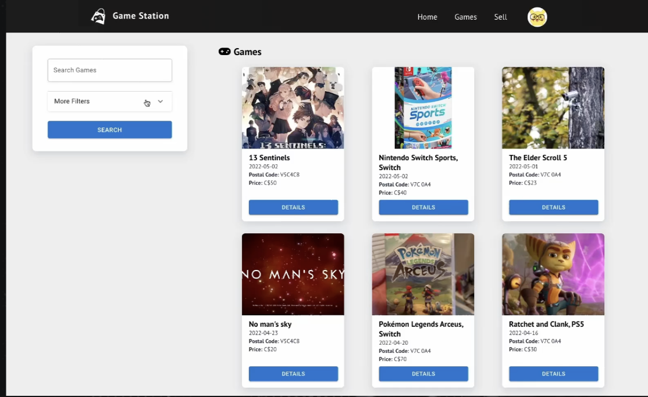
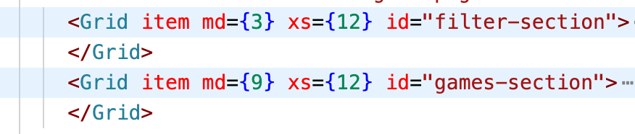
REFLECTION
#PROUDEST FEATURES – FILTERS
Our filters are multi-functional and accurate. We can not only search games with keywords, but also add more conditions to make the search results more accurate.
The filters have different styles depending on the width of the device. For desktops, their width accounts for one quarter. For mobile devices, their width is full-screen. To realize this, we used Grid from Material-UI

Slide 12
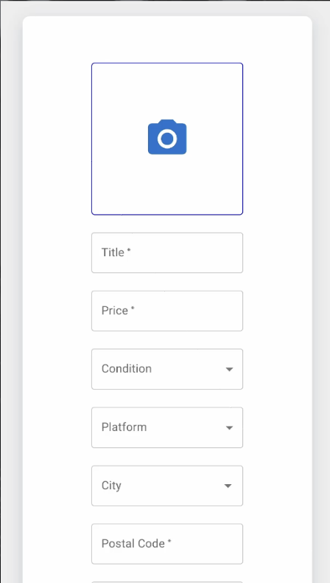
REFLECTION
#MOST CHALLENGING
When posting a game, we allow users to upload at least one image, and at most 3 images
1st step: Find a 3rd party platform to manage images. We chose Cloudinary API to upload an image from the front-end, and it will store the image and return the image’s url. So that we can store the url in our database and display the image with that.
2nd step: Enable to upload and change an image. We used Input and IconButton from Material UI. The UI interaction is simple, the user just needs to click the icon button to upload. When the image is successfully uploaded, the image the user uploaded will be shown instead of the camera icon. Also, the image can be changed if click the button again.

Slide 13
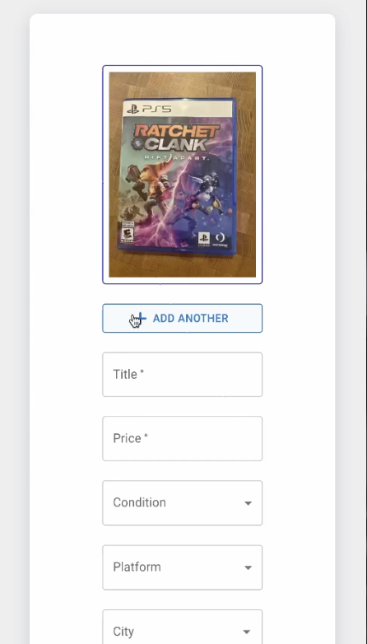
REFLECTION
#MOST CHALLENGING
3rd step: Enable to store multiple images for each post. To solve that, we use an array to store multiple urls instead of a string.
4th step: Enable to add another image. An ADD ANOTHER button will show if one user has used all the upload buttons. Then, another upload button will show for users to upload images.
5th step: Enable to delete an image. We understand that users may regret to upload another image and withdraw previous choices. So a DELETE ONE button will appear when users have uploaded more than one image. When an image is deleted, the array we used to store urls will also delete that url. Also, based on this solution. We also allow users to edit posted game’s images.

Slide 14

TODO
#THE NEXT STEP
#0
We would add website navigation using text and symbols to navigate new users about how to use the different services we provided.
Paginations are needed if we commercialize our website, and we want to split our games and comments into multiple pages to increase usability and website efficiency.
We want to give users more flexibility to edit their username and other information on their profile page.
We understand that viewing history is not enough for users who want to collect their favorite games. So we will add a wishlist feature for users to collect their favorite games and also see them both on home page and profile page.
#1
#2
#3

